Slide 1

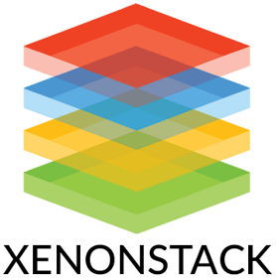
L1 : Module 3
Presented By- Keshav Jha
Role- Associate Software Engineer

Slide 2
Table Of Content
CI/CD A Gentle Introduction
Cloud Basics
Configuration Management
Deployment Strategies
What is DevOps
Infra as Code Basics
Linux Custom Script Tasks
Linux

Slide 3
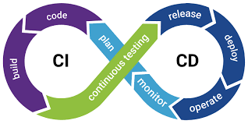
CI/CD A Gentle Introduction
What is CI/CD?
CI/CD stands for Continuous Integration and Continuous Delivery/Deployment, which are modern software development practices aimed at automating the process of integrating, testing, and deploying code changes. It is a cornerstone of DevOps, enabling teams to deliver software faster, with higher quality, and reduced risk.
Continuous Integration (CI) Continuous Integration is the practice of frequently merging code changes from multiple developers into a shared repository (e.g., GitHub, GitLab). Each integration triggers an automated build and testing process to ensure the new code works with the existing codebase.
Key Features:
Automated builds and testing.
Early detection of integration issues.
Encourages small, incremental code changes.
How CI Works:
Developers write code and push it to a version control system (e.g., Git).
A CI tool (e.g., Jenkins, GitLab CI/CD) detects the changes and triggers a pipeline.
The pipeline compiles the code, runs automated tests, and generates reports.
If the tests pass, the code is considered ready for the next stage (e.g., deployment).
Benefits of CI:
Reduces integration problems by catching bugs early.
Encourages collaboration among developers.
Provides fast feedback on code quality.

Slide 4
CI/CD A Gentle Introduction
Continuous Delivery (CD): Continuous Delivery extends CI by automating the release process. It ensures that the application is always in a deployable state, but deployment to production is a manual decision.
Key Features:
Automates packaging and release preparation.
Deploys code to staging environments for further testing.
Requires human approval for production deployment.
How CD Works:
After CI, the code is packaged into deployable artifacts (e.g., Docker images, JAR files).
The artifacts are deployed to a staging environment.
QA teams or automated tests validate the application in staging.
Once approved, the code is ready for production deployment.
Benefits of CD:
Reduces the time and effort required to release software.
Ensures consistent and reliable deployments.
Improves collaboration between development and operations teams.
Popular CI/CD Tools
Jenkins:
Open-source automation server.
Highly customizable with plugins.
Example: Automating the build and deployment of a Java application.
GitLab CI/CD:
Integrated with GitLab for seamless CI/CD.
Example: Running CI/CD pipelines directly from GitLab repositories.
CircleCI:
Cloud-based CI/CD platform.
Example: Automating the testing and deployment of a Node.js application.
Travis CI:
Popular for open-source projects.
Example: Running automated tests for a Python library.
GitHub Actions:
CI/CD workflows integrated with GitHub.
Example: Automating the deployment of a React application to AWS.

Slide 5
CI/CD A Gentle Introduction
CI/CD Pipeline Stages
Source Code Management:
Developers push code to a version control system (e.g., Git).
Build:
The application is compiled and packaged.
Test:
Automated tests (unit, integration, functional) are executed.
Release:
The application is prepared for deployment (e.g., creating Docker images)
Deploy:
Code is deployed to staging or production environments.
Monitor:
Application performance and errors are monitored post-deployment.
Continuous Deployment: Continuous Deployment automates the entire pipeline, including deployment to production. Every change that passes automated tests is deployed to production without manual intervention.
Key Features:
Fully automated pipeline.
No manual approval required for production deployment.
Requires robust automated testing and monitoring.
How Continuous Deployment Works:
After CI/CD, the code is automatically deployed to production.
Monitoring tools (e.g., Prometheus, Datadog) track application performance and errors.
If an issue is detected, the pipeline can trigger a rollback.
Benefits of Continuous Deployment:
Enables rapid delivery of features and bug fixes.
Reduces human error in the deployment process.
Provides immediate feedback from real users.

Slide 6
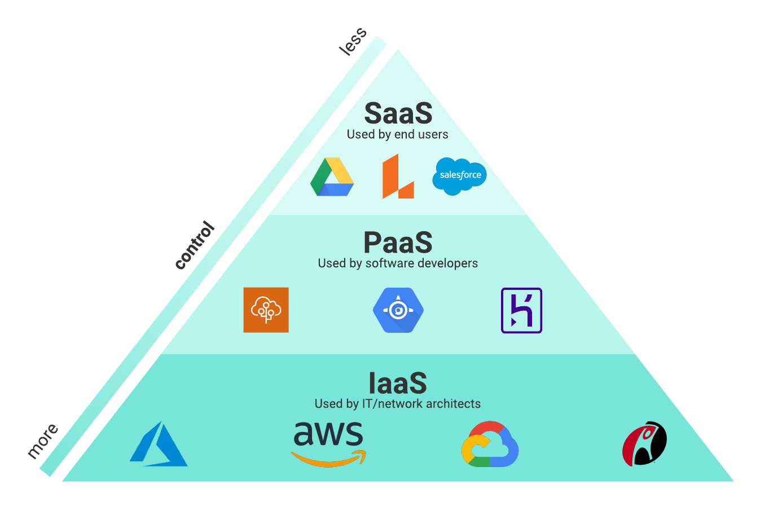
Cloud Basics
What is Cloud Computing?
Cloud computing refers to the delivery of computing services, such as servers, storage, databases, networking, software, analytics, and intelligence—over the internet ("the cloud"). It eliminates the need for owning physical hardware and allows users to access resources on-demand, paying only for what they use.
Types of Cloud Deployment Models
Public Cloud:
Owned and operated by third-party providers.
Resources are shared among multiple users (multi-tenancy).
Examples: Amazon Web Services (AWS), Microsoft Azure, Google Cloud Platform (GCP).
Private Cloud:
Dedicated to a single organization.
Offers greater control, security, and customization.
Can be hosted on-premises or by a third-party provider.
Example: VMware vSphere.
Hybrid Cloud:
Combines public and private clouds, allowing data and applications to move between them.
Provides flexibility, scalability, and cost optimization.
Example: A company may use a private cloud for sensitive data and a public cloud for less critical workloads.
Community Cloud:
Shared by organizations with similar needs (e.g., government agencies, research institutions).
Offers a balance of cost-sharing and customization.
Key Characteristics of Cloud Computing
On-Demand Self-Service:
Users can provision resources (e.g., virtual machines, storage) as needed without requiring human intervention from the service provider.
Broad Network Access:
Services are accessible over the internet from a wide range of devices, including laptops, smartphones, and tablets.
Resource Pooling:
Cloud providers pool resources to serve multiple customers using a multi-tenant model. Resources are dynamically allocated and reallocated based on demand.
Scalability and Elasticity:
Resources can be scaled up or down automatically or manually to meet workload demands. This ensures optimal performance and cost efficiency.
Measured Service:
Cloud systems automatically monitor and optimize resource usage. Customers are billed based on their usage, often referred to as the "pay-as-you-go" model.
High Availability and Reliability:
Cloud providers offer redundancy and failover mechanisms to ensure services remain available even during hardware or network failures.

Slide 7
Cloud Basics
Cloud Service Models
Infrastructure as a Service (IaaS): Provides virtualized computing resources over the internet.
Users manage operating systems, applications, and middleware, while the provider manages the infrastructure.
Examples:
Amazon EC2: Virtual servers.
Google Compute Engine: Scalable virtual machines.
Microsoft Azure Virtual Machines: Cloud-based virtual servers.
Platform as a Service (PaaS): Offers a platform for developers to build, test, and deploy applications without managing the underlying infrastructure.
Examples:
Google App Engine: Application hosting.
Microsoft Azure App Service: Web and mobile app development.
Heroku: Application deployment and scaling.
Software as a Service (SaaS): Delivers software applications over the internet on a subscription basis.
Users access applications via a web browser without worrying about installation or maintenance.
Examples:
Gmail: Email service.
Microsoft 365: Office productivity tools.
Salesforce: Customer relationship management (CRM).
Function as a Service (FaaS) (Serverless Computing):
Allows developers to run code in response to events without managing servers.
Examples:
AWS Lambda: Event-driven serverless computing.
Google Cloud Functions: Lightweight, event-based functions.
Azure Functions: Serverless application development.

Slide 8
Cloud Basics
Benefits of Cloud Computing
Cost Efficiency:
Reduces capital expenses (CapEx) by eliminating the need for physical hardware.
Operates on an operational expense (OpEx) model, where users pay only for what they use.
Scalability:
Easily scale resources up or down based on demand, ensuring optimal performance during peak times.
Accessibility:
Access resources and applications from anywhere with an internet connection, enabling remote work and collaboration.
Disaster Recovery and Backup:
Cloud providers offer robust backup and disaster recovery solutions, ensuring business continuity in case of data loss or system failure.
Collaboration:
Teams can collaborate in real-time using shared tools and platforms, improving productivity.
Automatic Updates:
Cloud providers handle software updates, security patches, and maintenance, reducing the burden on IT teams.
Global Reach:
Cloud providers have data centers worldwide, enabling businesses to deploy applications closer to their users for better performance.
Challenges of Cloud Computing
Security and Privacy:
Storing sensitive data in the cloud raises concerns about data breaches, unauthorized access, and compliance with regulations.
Downtime:
Dependence on internet connectivity and provider reliability can lead to service interruptions.
Compliance:
Organizations must ensure their cloud usage complies with industry regulations (e.g., GDPR, HIPAA).
Vendor Lock-In:
Migrating from one cloud provider to another can be complex and costly due to differences in platforms and services.
Hidden Costs:
While cloud computing is cost-effective, unexpected costs (e.g., data transfer fees, over-provisioning) can arise.

Slide 9
Configuration Managements
Configuration Management (CM) is a systematic process used to manage and control changes in systems, software, hardware, or infrastructure. It ensures that the system's performance, functionality, and design remain consistent and reliable throughout its lifecycle. CM is widely used in IT, software development, and engineering to maintain the integrity and traceability of configurations.
Key Objectives of Configuration Management:
Consistency: Ensure that the system's configuration remains consistent across environments (e.g., development, testing, production).
Change Control: Manage and document changes to prevent unauthorized or unintended modifications.
Traceability: Track the history of changes to understand what was changed, why, and by whom.
Automation: Automate repetitive tasks to reduce errors and improve efficiency.
Compliance: Ensure adherence to organizational policies, standards, and regulatory requirements.
Components of Configuration Management
Configuration Items (CIs):
These are the components being managed, such as software, hardware, documents, or processes.
Each CI is uniquely identified and tracked.
Configuration Management Database (CMDB):
A centralized repository that stores information about all CIs and their relationships.
Helps in understanding dependencies and impacts of changes.
Version Control:
Tracks changes to files, code, or configurations over time.
Tools like Git, SVN, or Mercurial are commonly used for version control.
Change Management:
A process to evaluate, approve, and implement changes to configurations.
Ensures that changes are planned, tested, and documented.
Baseline:
A snapshot of a system's configuration at a specific point in time.
Used as a reference to compare future changes.

Slide 10
Configuration Managements
Configuration Management in IT and Software Development
In IT and software development, CM is critical for managing infrastructure, code, and deployments. It is often implemented using tools and frameworks that automate configuration tasks.
Popular Configuration Management Tools:
Ansible:
Open-source tool for automating IT tasks like provisioning, configuration, and deployment.
Uses YAML for configuration files.
Puppet:
Automates infrastructure management and enforces desired states.
Uses a declarative language for configurations.
Chef:
Automates infrastructure as code (IaC) using Ruby-based DSL.
Focuses on managing servers and cloud environments.
Terraform:
Manages infrastructure as code for provisioning and managing cloud resources.
Works with multiple cloud providers.
SaltStack:
Provides configuration management and orchestration for large-scale environments.
Git:
A version control system for tracking changes in code and configurations.
Configuration Management in Engineering
In engineering, CM is used to manage product designs, manufacturing processes, and documentation. It ensures that all components of a product are properly documented and controlled.
Key Activities in Engineering CM:
Document Control: Managing design documents, blueprints, and specifications.
Change Control: Tracking and approving changes to designs or processes.
Product Lifecycle Management (PLM): Managing the entire lifecycle of a product from design to disposal.
Configuration Management Process
Identification:
Define and document all configuration items (CIs) and their attributes.
Control:
Implement processes to manage changes to configurations.
Use tools to enforce policies and track changes.
Status Accounting:
Record and report the status of CIs and their changes.
Verification and Audit:
Regularly review configurations to ensure compliance with baselines and standards.

Slide 11
Deployment Strategies
Deployment strategies refer to the methods and processes used to release new software, updates, or features into production environments. These strategies aim to ensure smooth, reliable, and efficient deployment while minimizing risks, downtime, and disruptions to users.
Choosing the right deployment strategy depends on factors such as the nature of the application, the level of risk tolerance, the need for high availability, and the ability to roll back changes if issues arise.
Common Deployment Strategies​
1. Recreate Deployment (Big Bang Deployment)​
Description: The old version of the application is completely shut down, and the new version is deployed in its place.​
Process: ​
Stop the current application.​
Deploy the new version.​
Start the new application.​
Advantages: ​
Simple and straightforward.​
No overlap between old and new versions.​
Disadvantages: ​
Causes downtime during the deployment process.​
High risk if the new version fails, as rollback can be time-consuming.​
Use Case: Suitable for small applications or systems where downtime is acceptable.​
2. Rolling Deployment​
Description: The new version is gradually rolled out to a subset of servers or instances, replacing the old version incrementally.​
Process: ​​
Deploy the new version to a small group of servers.​​
Monitor for issues.​​
Gradually expand the deployment to all servers.​​
Advantages: ​​
No downtime for users.​​
Easier to identify and fix issues during the rollout.​​
Disadvantages: ​​
Requires careful monitoring and management.​​
Temporary coexistence of old and new versions may cause compatibility issues.​​
Use Case: Ideal for large-scale distributed systems or cloud-based applications.​​
3. Blue-Green Deployment
Description: Two identical environments (Blue and Green) are maintained. The new version is deployed to the inactive environment (Green), and traffic is switched to it once testing is complete.
Process:
Deploy the new version to the Green environment.
Test the new version in Green.
Switch traffic from Blue to Green.
Advantages:
Zero downtime during deployment.
Easy rollback by switching traffic back to Blue.

Slide 12
Deployment Strategies
Disadvantages:
Requires double the infrastructure (Blue and Green environments).
Higher cost due to maintaining two environments.
Use Case: Suitable for mission-critical applications where downtime is unacceptable.
4. Canary Deployment
Description: The new version is deployed to a small subset of users or servers (the "canary group") before being rolled out to the entire user base.
Process:
Deploy the new version to a small group of users or servers.
Monitor performance and user feedback.
Gradually expand the deployment to all users.
Advantages:
Reduces risk by testing the new version on a small scale.
Issues can be identified and fixed before full deployment.
Disadvantages:
Requires robust monitoring and feedback mechanisms.
Temporary coexistence of old and new versions may cause inconsistencies.
Use Case: Common in cloud-based applications and services with a large user base.
5. A/B Testing Deployment
Description: A subset of users is directed to the new version (B), while the rest continue using the old version (A). This allows comparison of performance and user behavior.
Process:
Deploy the new version alongside the old version.
Route a portion of traffic to the new version.
Collect data and analyze results.
Advantages:
Provides valuable insights into user behavior and performance.
Allows data-driven decisions about whether to fully deploy the new version.
Disadvantages:
Requires advanced traffic routing and monitoring tools.
May cause confusion for users if versions behave differently.
Use Case: Ideal for testing new features or changes in user-facing applications.
6. Shadow Deployment
Description: The new version is deployed alongside the old version, but only receives a copy of the live traffic for testing purposes. Users are not affected.
Process:
Deploy the new version in a shadow environment.
Mirror live traffic to the shadow environment.
Monitor the new version's performance without affecting users.
Advantages:
No impact on users during testing.
Allows testing with real-world traffic.

Slide 13
Deployment Strategies
7. Feature Toggles (Feature Flags)
Description: New features are deployed in the codebase but are hidden behind feature toggles. Features can be enabled or disabled dynamically without redeploying the application.
Process:
Deploy the new version with feature toggles.
Gradually enable features for specific users or groups.
Monitor performance and feedback.
Advantages:
Allows gradual rollout of features without redeployment.
Easy to roll back by disabling the feature toggle.
Disadvantages:
Adds complexity to the codebase.
Requires careful management of feature toggles.
Use Case: Common in agile development and continuous delivery pipelines.
8. Immutable Deployment
Description: Instead of updating existing servers, new servers or instances are created with the new version, and the old ones are decommissioned.
Process:
Create new instances with the updated version.
Route traffic to the new instances.
Decommission the old instances.
Advantages:
Ensures a clean and consistent deployment.
Eliminates configuration drift.
Disadvantages:
Requires additional infrastructure during deployment.
Higher cost and complexity.
Use Case: Suitable for containerized or cloud-native applications.

Slide 14
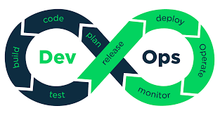
What is DevOps
DevOps is a set of practices, principles, and cultural philosophies that aim to bridge the gap between software development (Dev) and IT operations (Ops). It focuses on improving collaboration, communication, and integration between development and operations teams to deliver high-quality software faster and more reliably.
DevOps is not a tool or a specific technology but rather a cultural shift that emphasizes automation, continuous delivery, and shared responsibility for the entire software lifecycle—from development and testing to deployment and operations.
Key Principles of DevOps
Collaboration and Communication:
Breaks down silos between development and operations teams.
Encourages shared goals and responsibilities.
Automation:
Automates repetitive tasks such as testing, deployment, and infrastructure provisioning.
Reduces human errors and speeds up processes.
Continuous Integration and Continuous Delivery (CI/CD):
Ensures that code changes are integrated, tested, and deployed frequently and reliably.
Reduces the time between writing code and delivering it to production.
Infrastructure as Code (IaC):
Treats infrastructure (e.g., servers, networks) as code, allowing it to be versioned, tested, and automated.
Ensures consistency and scalability.
Monitoring and Feedback:
Implements robust monitoring and logging to track application performance and detect issues.
Provides feedback loops to improve future development and operations.
Agility and Iteration:
Encourages small, incremental changes rather than large, risky deployments.
Adapts quickly to changing requirements and user feedback.
Benefits of DevOps
Faster Time to Market:
Accelerates the software development and delivery process.
Enables organizations to release features and updates more frequently.
Improved Collaboration:
Aligns development and operations teams, fostering a culture of shared responsibility.
Higher Quality Software:
Automated testing and CI/CD pipelines ensure that code is thoroughly tested before deployment.
Reduced Downtime:
Continuous monitoring and quick rollbacks minimize downtime and improve system reliability.
Scalability:
Automating infrastructure and using IaC makes it easier to scale applications and environments.
Cost Efficiency:
Automation reduces manual effort, and early detection of issues prevents costly fixes later.

Slide 15
What is DevOps
DevOps Lifecycle:
The DevOps lifecycle consists of several stages that form a continuous loop of development, testing, deployment, and monitoring:
DevOps Practices
Continuous Integration (CI):
Developers frequently merge code changes into a shared repository.
Automated builds and tests are triggered to detect issues early.
Continuous Delivery (CD):
Ensures that code changes are automatically prepared for deployment to production.
Focuses on automating the release process.
Continuous Deployment:
Extends CD by automatically deploying every change that passes tests to production.
Requires robust testing and monitoring.
Infrastructure as Code (IaC):
Manages infrastructure using code and automation tools.
Tools: Terraform, AWS CloudFormation, Ansible.
Microservices Architecture:
Breaks applications into smaller, independent services that can be developed and deployed separately.
Tools: Docker, Kubernetes.
Monitoring and Logging:
Tracks application performance and logs events to identify and resolve issues.
Tools: Prometheus, Grafana, ELK Stack.
Version Control:
Tracks changes to code and configurations, enabling collaboration and rollback.
Tools: Git, SVN.
Plan:
Define requirements, goals, and tasks for the software project.
Tools: Jira, Trello, Azure Boards.
Develop:
Write and build the application code.
Tools: Git, GitHub, GitLab, Bitbucket.
Build:
Compile the code and create build artifacts.
Tools: Jenkins, Maven, Gradle.
Test:
Perform automated and manual testing to ensure code quality.
Tools: Selenium, JUnit, TestNG.
Release:
Package and prepare the application for deployment.
Tools: Jenkins, GitLab CI/CD, CircleCI.
Deploy:
Deploy the application to production or staging environments.
Tools: Kubernetes, Docker, Ansible.
Operate:
Manage and monitor the application in production.
Tools: Nagios, Prometheus, Datadog.
Monitor:
Continuously monitor application performance and user feedback.
Tools: Splunk, ELK Stack, New Relic.

Slide 16
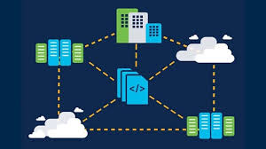
Infra as Code (IaC): Basics
Infrastructure as Code (IaC) is a practice in which infrastructure (e.g., servers, networks, databases, and other IT resources) is provisioned, managed, and configured using code and automation tools, rather than manual processes. IaC treats infrastructure in the same way as application code, allowing it to be versioned, tested, and deployed consistently.
IaC is a key component of modern DevOps practices, enabling teams to automate infrastructure provisioning, reduce errors, and achieve scalability and consistency.
Key Concepts of IaC
1. Declarative vs Imperative Approach
Declarative:
Specifies what the desired state of the infrastructure should be.
The IaC tool determines how to achieve that state.
Example: Terraform, AWS CloudFormation.
Imperative:
Specifies how to achieve the desired state step by step.
Example: Ansible, Shell scripts.
2. Idempotency
Ensures that applying the same IaC code multiple times results in the same infrastructure state, regardless of the current state.
Prevents unintended changes or duplication.
3. Version Control
IaC files are stored in version control systems (e.g., Git), enabling teams to track changes, collaborate, and roll back to previous versions if needed.
4. Automation
Automates the provisioning and configuration of infrastructure, reducing manual effort and errors.
5. Infrastructure Abstraction
Abstracts infrastructure resources (e.g., servers, networks) into code, making it easier to manage and scale.
Benefits of IaC
Consistency:
Ensures that infrastructure is provisioned and configured the same way every time, reducing configuration drift.
Scalability:
Automates the creation of infrastructure, making it easy to scale up or down based on demand.
Speed:
Reduces the time required to provision and configure infrastructure, enabling faster deployments.
Collaboration:
Teams can collaborate on infrastructure code using version control systems, just like application code.
Cost Efficiency:
Automates resource management, reducing over-provisioning and manual errors.
Disaster Recovery:
Infrastructure can be quickly recreated from code in case of failures.
Testing and Validation:
Infrastructure can be tested and validated before deployment, reducing risks.

Slide 17
Infra as Code (IaC): Basics
IaC Workflow
Write Code:
Define the desired state of infrastructure in configuration files.
Version Control:
Store the IaC files in a version control system (e.g., Git).
Plan:
Use IaC tools to generate a plan that shows the changes required to achieve the desired state.
Apply:
Execute the IaC code to provision or update the infrastructure.
Monitor:
Continuously monitor the infrastructure to ensure it remains in the desired state.
Update:
Modify the IaC code to make changes to the infrastructure and reapply.
Components of IaC
Configuration Files:
Written in a specific language (e.g., YAML, JSON, HCL) to define the desired state of infrastructure.
IaC Tools:
Tools that interpret the configuration files and provision the infrastructure.
Version Control:
Systems like Git to store and manage IaC files.
Execution Environment:
The environment where IaC tools run (e.g., local machine, CI/CD pipeline).
Popular IaC Tools
1. Terraform
Open-source tool for provisioning and managing infrastructure across multiple cloud providers (e.g., AWS, Azure, GCP).
Uses a declarative language called HCL (HashiCorp Configuration Language).
Supports multi-cloud and hybrid environments.
2. AWS CloudFormation
A service provided by AWS to define and provision AWS resources using JSON or YAML templates.
Focused on AWS-specific infrastructure.
3. Ansible
A configuration management and automation tool that can also provision infrastructure.
Uses YAML for playbooks and follows an imperative approach.
4. Chef
Automates infrastructure configuration and management using Ruby-based DSL (Domain-Specific Language).
Focuses on configuration management.
5. Puppet
A configuration management tool that automates the provisioning and management of infrastructure.
Uses a declarative language.
6. SaltStack
A configuration management and orchestration tool for managing infrastructure at scale.
7. Pulumi
Allows infrastructure to be defined using general-purpose programming languages like Python, JavaScript, and Go.

Slide 18
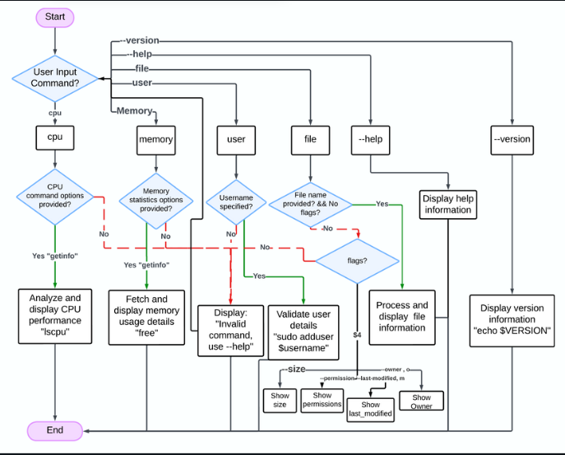
Linux Custom Script Tasks
Fig: Flowchart

Slide 19

Linux
Linux is a free, open-source, Unix-like operating system (OS) kernel that serves as the foundation for a wide variety of operating systems, commonly referred to as Linux distributions. It was created by Linus Torvalds in 1991 and has since become one of the most widely used operating systems in the world, powering everything from personal computers to servers, smartphones, embedded systems, and supercomputers.
Key Features of Linux:
Open Source: The source code is freely available, allowing anyone to view, modify, and distribute it.
Multi-User: Multiple users can use the system simultaneously without interfering with each other.
Multitasking: Linux can handle multiple tasks or processes at the same time.
Portability: Linux can run on a wide variety of hardware platforms, from small embedded devices to large mainframes.
Security: Linux is known for its robust security features, including user permissions, firewalls, and encryption.
Stability: Linux systems are highly stable and can run for years without requiring a reboot.
Customizability: Users can customize Linux to suit their needs, from the kernel to the desktop environment.
Community Support: A large, active community provides support, documentation, and software.
Advantages of Linux
Cost: Free to use and distribute.
Security: Less prone to malware and viruses compared to other operating systems.
Performance: Efficient resource management makes it suitable for high-performance tasks.
Flexibility: Can be tailored for specific use cases.
Community Support: Extensive documentation and forums for troubleshooting.
Disadvantages of Linux
Learning Curve: Can be challenging for beginners, especially without a GUI.
Software Compatibility: Some proprietary software is not available for Linux.
Hardware Support: Certain hardware may lack drivers or support.
Applications of Linux
Linux is used in a wide range of fields due to its flexibility and reliability:
1. Servers
2. Embedded Systems:
3. Supercomputers:
4. Desktop Computing:
5. Mobile Devices:
6. Development:

Slide 20
Linux
Basic Linux Commands: Here are some commonly used Linux commands
File and Directory Management:
ls: List files and directories.
cd: Change directory.
pwd: Print the current working directory.
mkdir: Create a new directory.
rm: Remove files or directories.
cp: Copy files or directories.
mv: Move or rename files.
File Viewing and Editing:
cat: View file contents.
nano or vim: Edit files.
less: View file contents one page at a time.
System Monitoring:
top: Display running processes.
df: Show disk space usage.
free: Display memory usage.
User Management:
whoami: Show the current user.
adduser: Add a new user.
passwd: Change a user's password.
Package Management (varies by distro):
apt (Debian/Ubuntu): Install, update, or remove software.
yum or dnf (RHEL/Fedora): Manage packages.
pacman (Arch): Manage packages.

Slide 21
Thank You!!

